Slide 1
Object Oriented Programming
Week 4
Abeer GAUHER
Email: abeer.gauher@nu.edu.pk
Office: CS BASEMENT 2, Office number 17

Slide 2
Destructors
Destructor is a member function which destructs or deletes an object.
When is destructor called? A destructor function is called automatically when the object goes out of scope: (1) the function ends (2) the program ends (3) a block containing local variables ends (4) a delete operator is called

Slide 3
How destructors are different from a normal member function?
Destructors have same name as the class preceded by a tilde (~)
Destructors don’t take any argument and don’t return anything
Destructors are usually used to deallocate memory and do other cleanup for a class object and its class members when the object is destroyed.

Slide 4
Can there be more than one destructor in a class? No, there can only one destructor in a class with classname preceded by ~, no parameters and no return type.
When do we need to write a user-defined destructor? If we do not write our own destructor in class, compiler creates a default destructor for us. The default destructor works fine unless we have dynamically allocated memory or pointer in class.

Slide 5
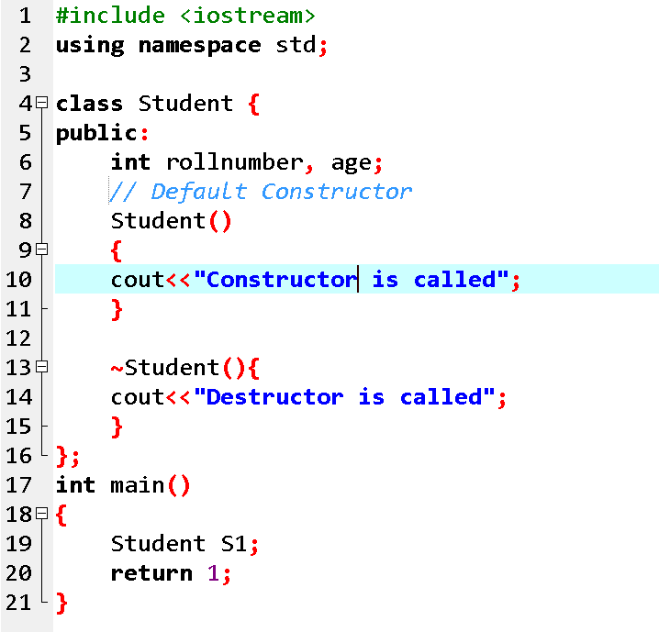

Slide 6
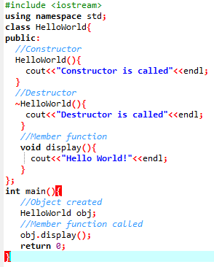


Slide 7
Overloading
Destructors cannot be overloaded

Slide 8
Destructors with DMA
Memory allocated with new cannot be used again, unless it is realased by delete. Never deleting memory is called a memory leak.
MyClass::MyClass()
{
n = new int;
p = new float;
x = new float[5];
}
The destructor should be
MyClass::~MyClass()
{
delete n;
delete p;
delete[] x;
}

Slide 9
Sequence of Calls
Constructors and destructors are called automatically
Constructors are called in the sequence in which object is declared
Destructors are called in reverse order

Slide 10
Example
Student::Student(char * aName){
…
cout << aName << “Cons\n”;
}
Student::~Student(){
cout << name << “Dest\n”;
}
};
int main()
{
Student studentB(“Ali”);
Student studentA(“Ahmad”);
return 0;
}

Slide 11
Example
Output:
Ali Cons
Ahmad Cons
Ahmad Dest
Ali Dest

Slide 12
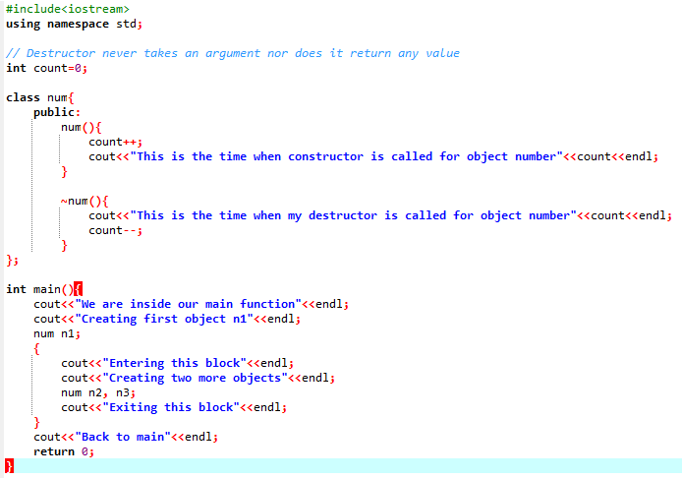
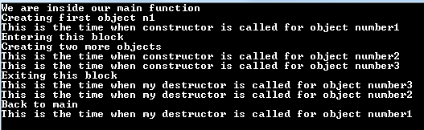
Example

Slide 13
const Keyword in C++
Constant is something that doesn't change.
In C language and C++ we use the keyword const to make program elements constant.
const keyword can be used in many contexts in a C++ program. It can be used with:
1) Variables 2) Pointers 3) Function arguments 4) Class Data members 5) Class Member functions 6) Objects

Slide 14
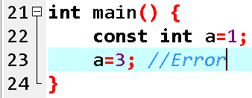
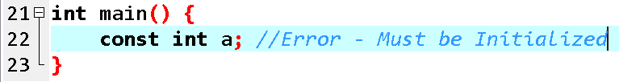
1) Constant Variables in C++
If you make any variable as constant, using const keyword, you cannot change its value. Also, the constant variables must be initialized while they are declared.

Slide 15
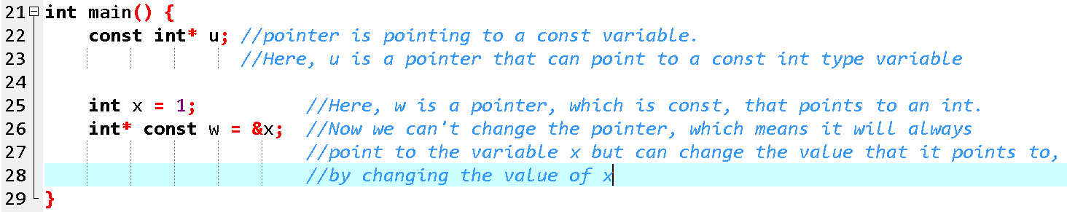
2) Pointers with const keyword in C++

Slide 16
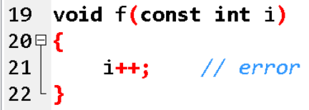
3) Function with constant Arguments
We can make the arguments of a function as const. Then we cannot change any of them.

Slide 17
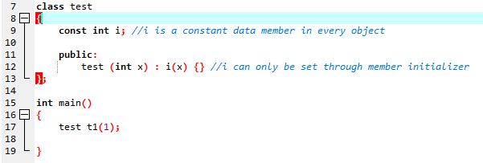
4) Defining Class Data members as const
These are data variables in class which are defined using const keyword. They are not initialized during declaration. Their initialization is done in the constructor.

Slide 18
5) Defining Class Object as const
When an object is declared or created using the const keyword, its data members can never be changed, during the object's lifetime.
Syntax:
const class_name object;

Slide 19
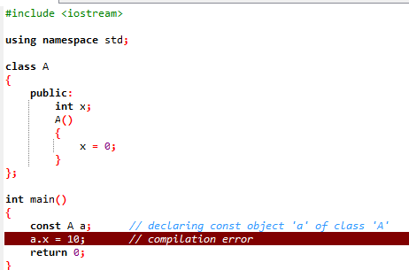
5) Defining Class Object as const

Slide 20
6) Defining Class's Member function as const
A const member function never modifies data members in an object.
A const member function cannot change the value of any data member of the class and cannot call any member function which is not constant.
To make any member function const, we add the const keyword after the list of the parameters after the function name.
Syntax:
return_type function_name() const;

Slide 21
6) Defining Class's Member function as const
A const object can only call a const member function.
This is because a const object cannot change the value of the data members and a const member function also cannot change the value of the data member of its class. So, a const object would like to call a function which does not violate its rule.
We cannot make constructors const.
The reason for this is that const objects initialize the values of their data members through constructors and if we make the constructor const, then the constructor would not change the values of the data members and the object would remain uninitialized.

Slide 22
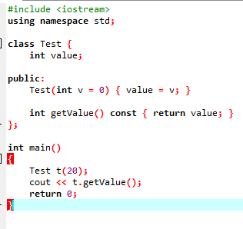
6) Defining Class's Member function as const

Slide 23
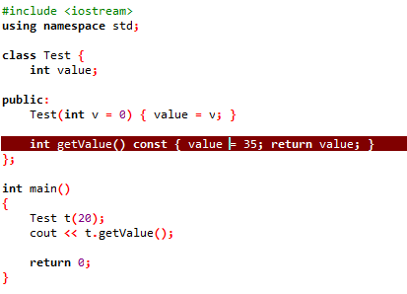
6) Defining Class's Member function as const

Slide 24
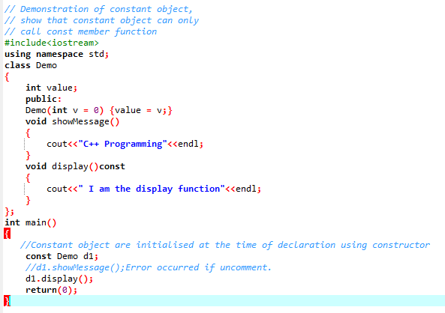

6) Defining Class's Member function as const

Slide 25
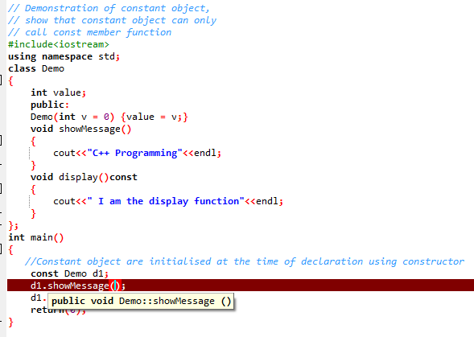
6) Defining Class's Member function as const

Slide 26
mutable Keyword
mutable keyword is used with member variables of class, which we want to change even if the object is of const type. Hence, mutable data members of a const objects can be modified.

Slide 27
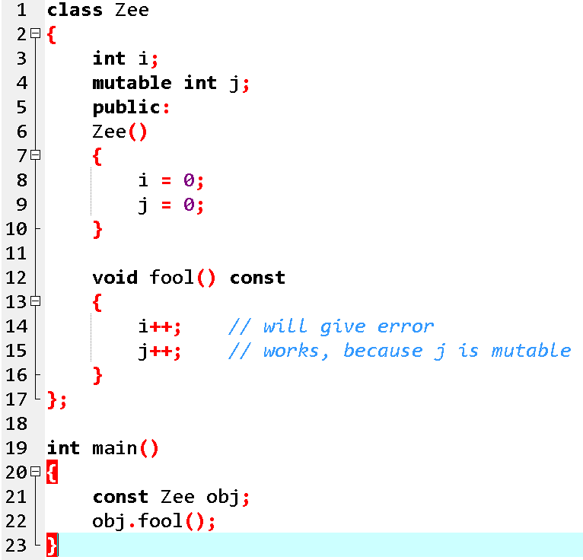
Example: Mutable

Slide 28
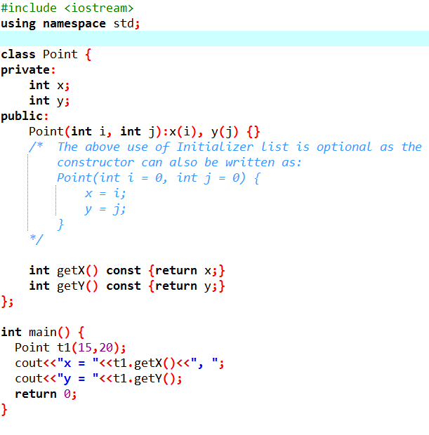
Initializer List
Initializer List is used in initializing the data members of a class.
The list of members to be initialized is indicated with constructor as a comma-separated list followed by a colon.

Slide 29
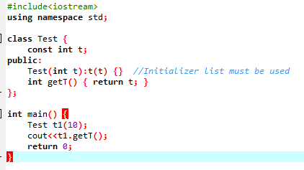
Initializer List
There are situations where initialization of data members inside constructor doesn’t work and Initializer List must be used. Following are such cases:
1) For initialization of non-static const data members:
const data members must be initialized using Initializer List.
“t” is a const data member of Test class and is initialized using Initializer List.

Slide 30
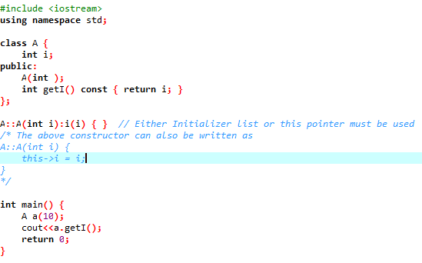
Initializer List
2) When constructor’s parameter name is same as data member
If constructor’s parameter name is same as data member name then the data member must be initialized either using this pointer or Initializer List.
both member name and parameter name for A() is “i”.

Slide 31
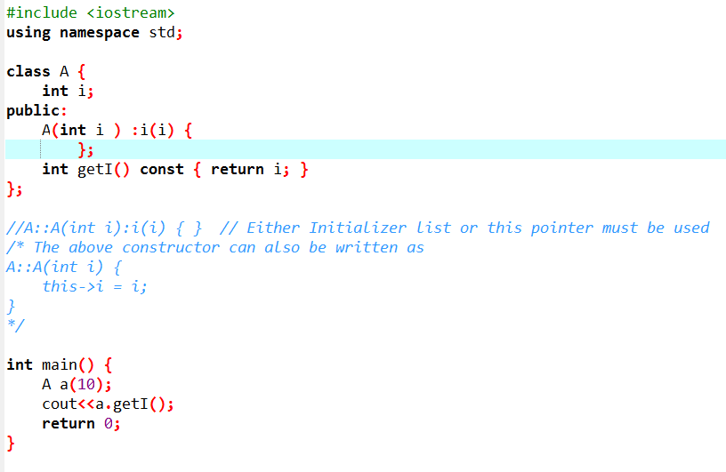
Initializer List

Slide 32
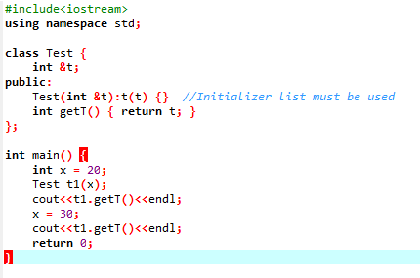

Initializer List
3) For initialization of reference members:
Reference members must be initialized using Initializer List.
“t” is a reference member of Test class and is initialized using Initializer List.

Slide 33
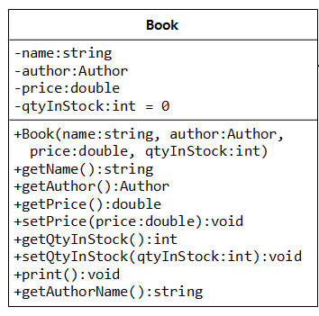
Question Time

